Slide 1




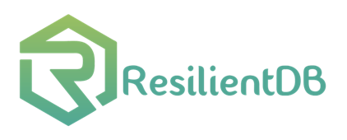
Permissioned Blockchain Through the Looking Glass: Architectural and Implementation Lessons Learned
Suyash Gupta
Sajjad Rahnama
Mohammad Sadoghi
MokaBlox LLC
Exploratory Systems Lab
University of California, Davis
*Proceedings of the 40th IEEE ICDCS 2020

Slide 2
What is Blockchain?
A linked list of blocks.
Each block contains hash of the previous block.
A block contains information about some client transactions.
New
Block
Previous
Hash
Genesis
Previous
Hash
Previous
Hash
Data
Data
Data
Client Transactions

Slide 3

Components of a Blockchain System
Replicas → Store all the data.
Client → Sends transactions to process.
Consensus Protocol → Helps ordering transactions.
Cryptographic Constructs → Authenticate replicas and clients.
Ledger → Records transactions.

Slide 4

Famous Blockchain Applications?

Slide 5
Why only Cryptocurrencies?
Throughput of initial cryptocurrencies → < 10 txns/s.
Throughput of existing distributed databases → 1 million txns/s.
Low throughput acceptable in permissionless applications.
Aim: 1) Cryptocurrency that is decentralized.
2) Identities are hidden or unknown.
Result: 1) Forks in the chain.
2)Not acceptable to industries.

Slide 6
Rise of Permissioned Blockchains
Only a selected group of replicas, although untrusted can participate.
Identities of the replica known a priori.
Prevent chain forks.
Suitable for needs of an industry → JP Morgan, IBM, Oracle
Open design of Blockchain Databases.
Throughput? < 10K txns/s.
Often cited reason → Traditional BFT consensus protocols are expensive!

Slide 7






At the core of any Blockchain application is a Byzantine Fault-Tolerant (BFT) consensus protocol.
Client
Crashed
Primary
Malicious

Slide 8
Can a well-crafted system based on a
classical BFT protocol outperform
a modern protocol?
ResilientDB employs three-phase (of which two require quadratic communication) PBFT protocol and scales better than protocol-centric permissioned blockchain system that uses single linear-phase Zyzzyva.

Slide 9
Existing Permissioned Blockchain systems overlook system design!
ResilientDB adopts well-researched database and system practices.
Visit at: https://resilientdb.com/

Slide 10
Dissecting existing Permissioned Blockchain
Single-threaded Monolithic Design
Successive Phases of Consensus
Integrated Ordering and Execution
Strict Ordering
Off-Chain Memory Management
Expensive Cryptographic Practices

Slide 11
ResilientDB Architecture
SECURE
LAYER
EXECUTION LAYER
THREADS
SIGNING
TOOLKIT
QUEUES
NET WORK
HASHING
TOOLKIT
BFT CONSENSUS
STORAGE LAYER
METADATA
BLOCKCHAIN

Slide 12
Multi-Threaded Deep Pipeline at Replicas
Network
Network
Client
Requests
Input
Batch Creation
Output
Message from
Clients and Replicas
Prepare
& Commit
Message to
Replicas and Clients
Worker
Execute
Checkpoint

Slide 13
Evaluation and Analysis
We ask eleven distinct questions that affect performance of a Permissioned Blockchain.
Workload provided by Yahoo Cloud Serving Benchmark (YCSB).
PBFT to achieve BFT consensus among replicas.
General Setup (unless stated otherwise):
8-core Intel Xeon Cascade Lake CPU.
Requests sent by 80K clients deployed on 4 machines.
Employed batching → Batch size set at 100.
At each replica → one worker-thread, one execute-thread and two batch-threads

Slide 14
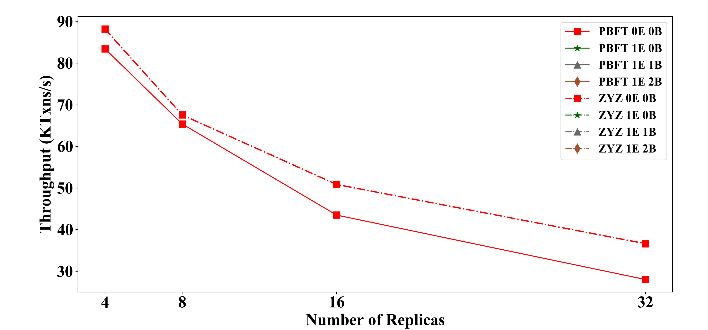
Insight 1: Multi-Threaded pipeline Gains
Parallelizing and Pipelining tasks across worker, execution (E) and batch-threads (B).

Slide 15
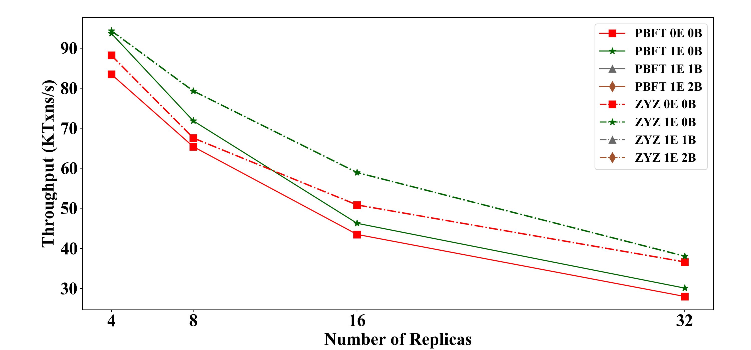
Insight 1: Multi-Threaded pipeline Gains
Parallelizing and Pipelining tasks across worker, execution (E) and batch-threads (B).

Slide 16
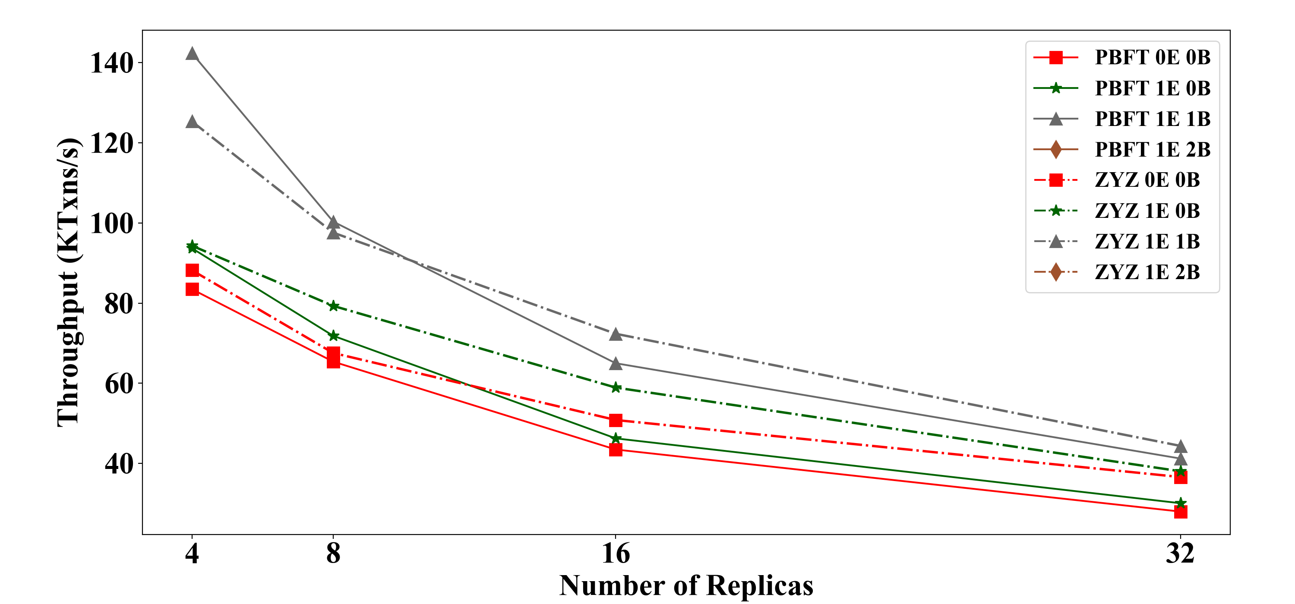
Insight 1: Multi-Threaded pipeline Gains
Parallelizing and Pipelining tasks across worker, execution (E) and batch-threads (B).

Slide 17
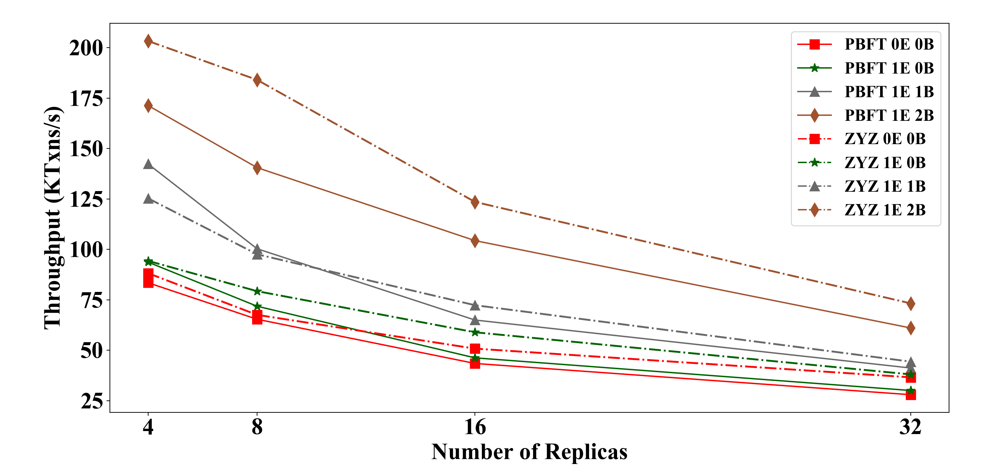
Insight 1: Multi-Threaded pipeline Gains
Parallelizing and Pipelining tasks across worker, execution (E) and batch-threads (B).

Slide 18
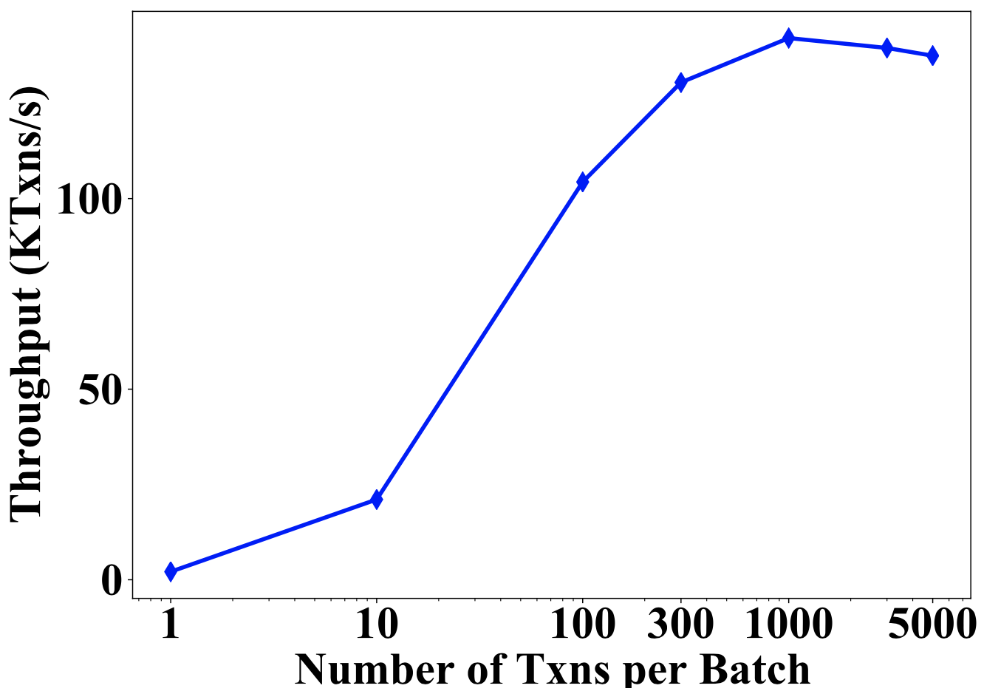
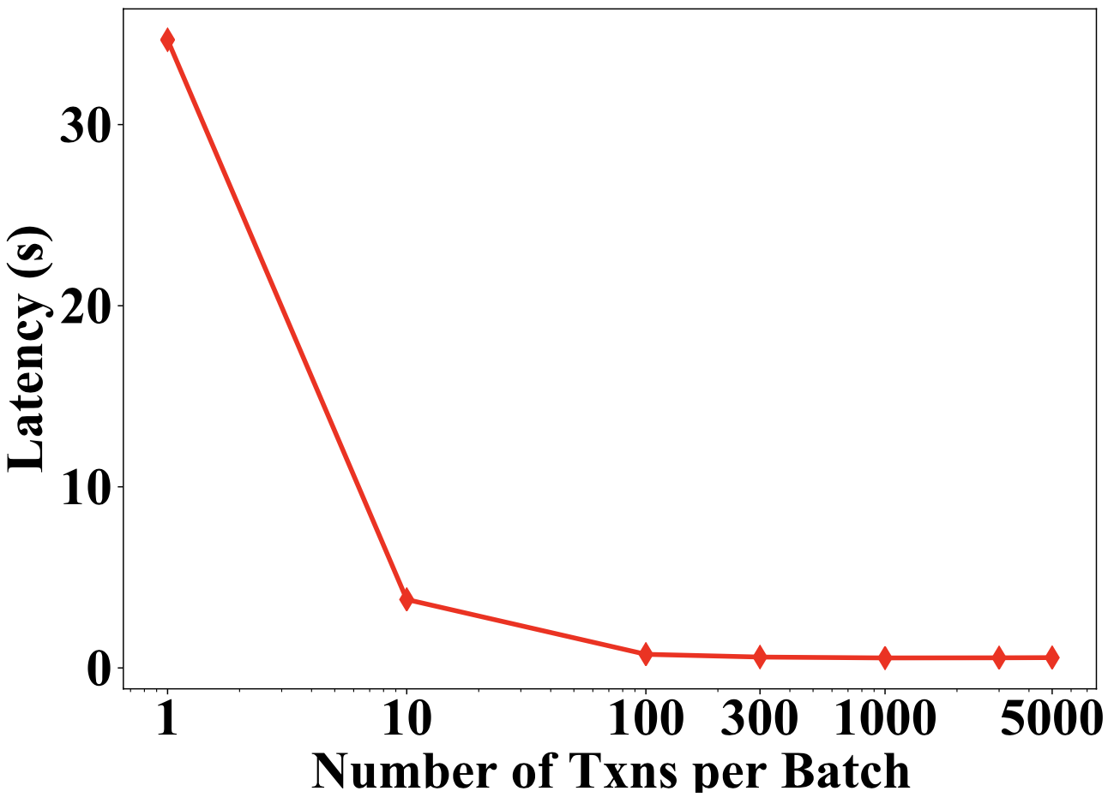
Insight 2: Optimal Batching Gains
More transactions batched together → increase in throughput
→reduced phases of consensus.

Slide 19
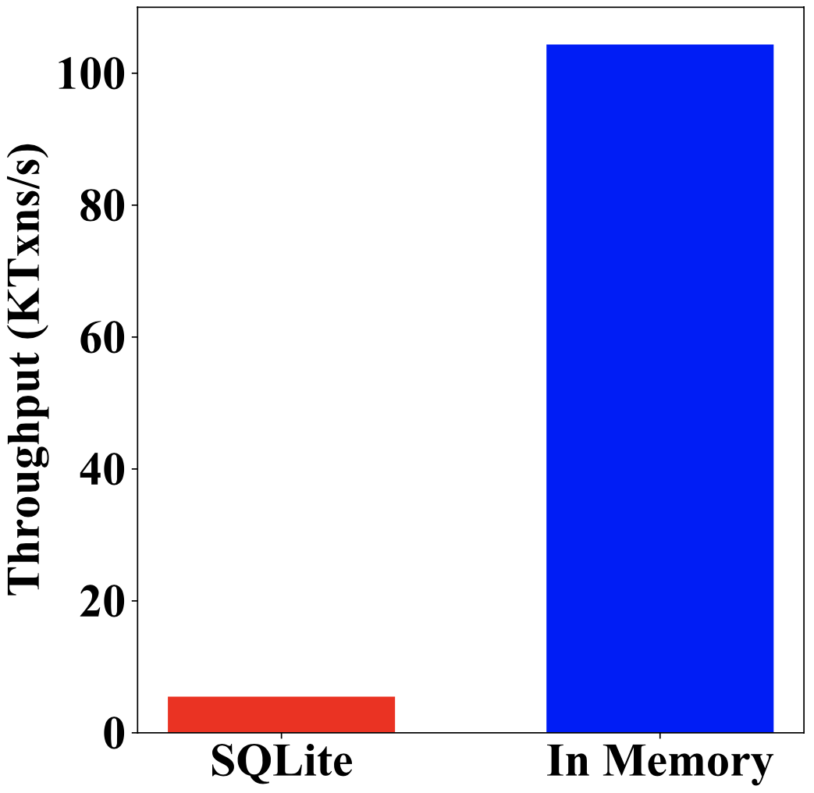
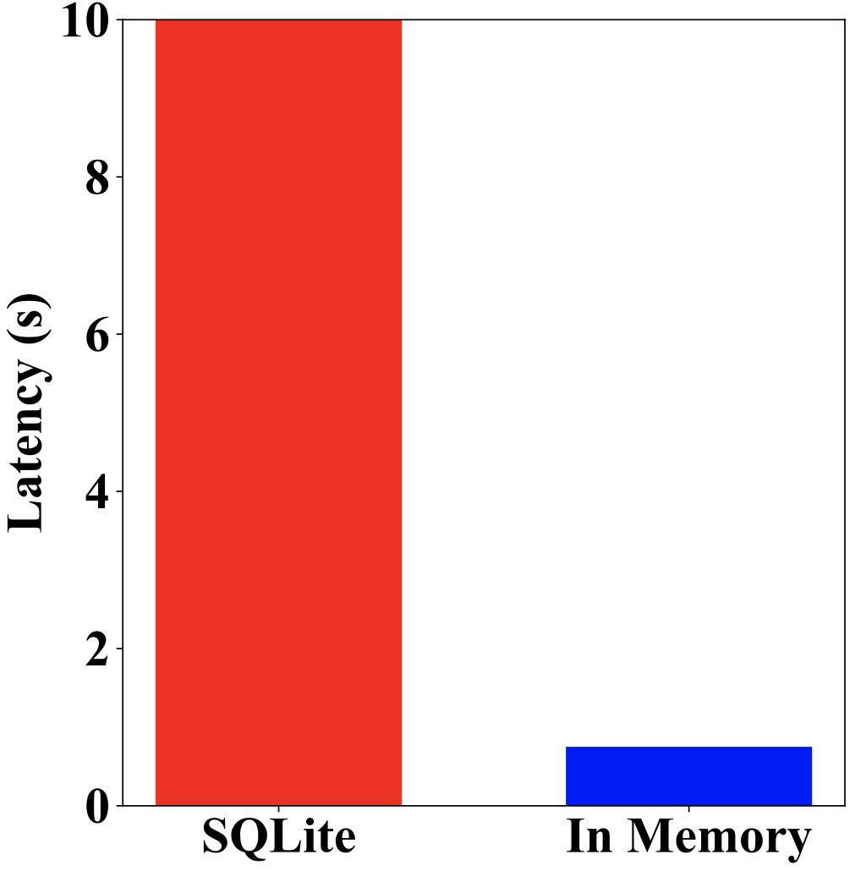
Insight 3: Memory Storage Gains
In-memory blockchain storage → reduces access cost.

Slide 20
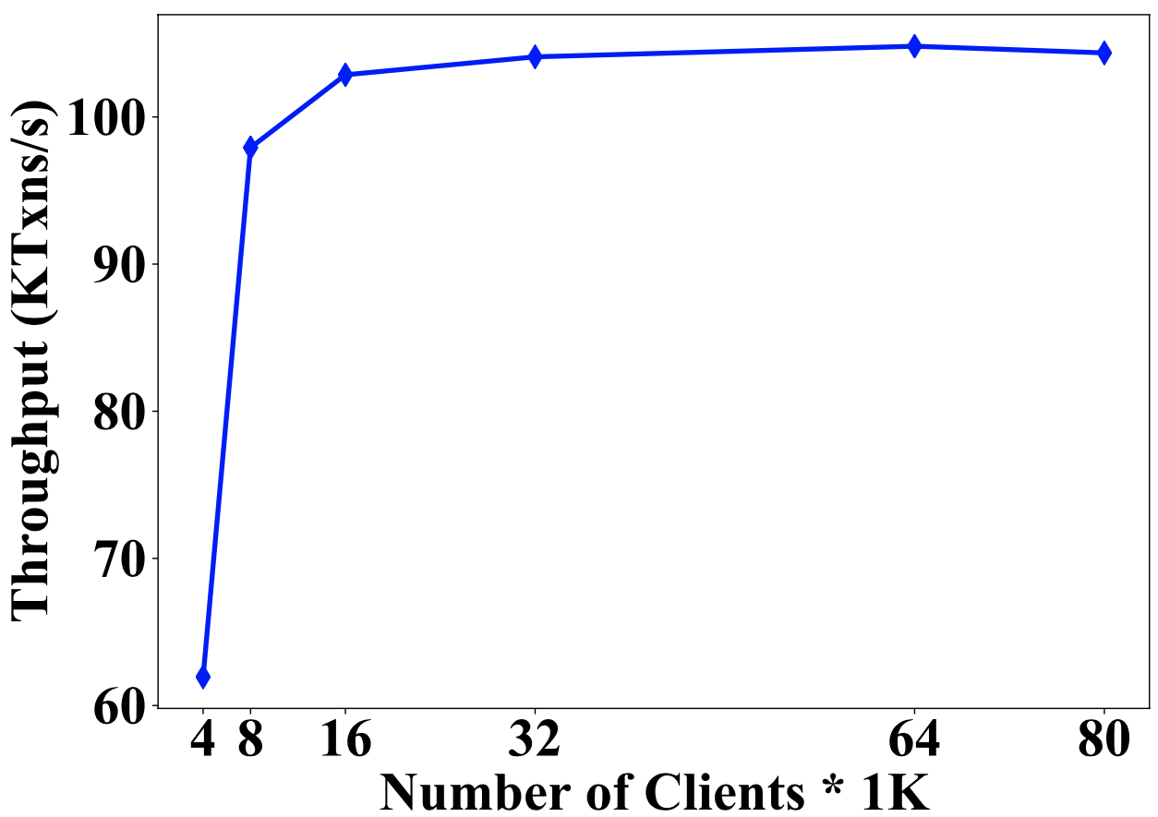
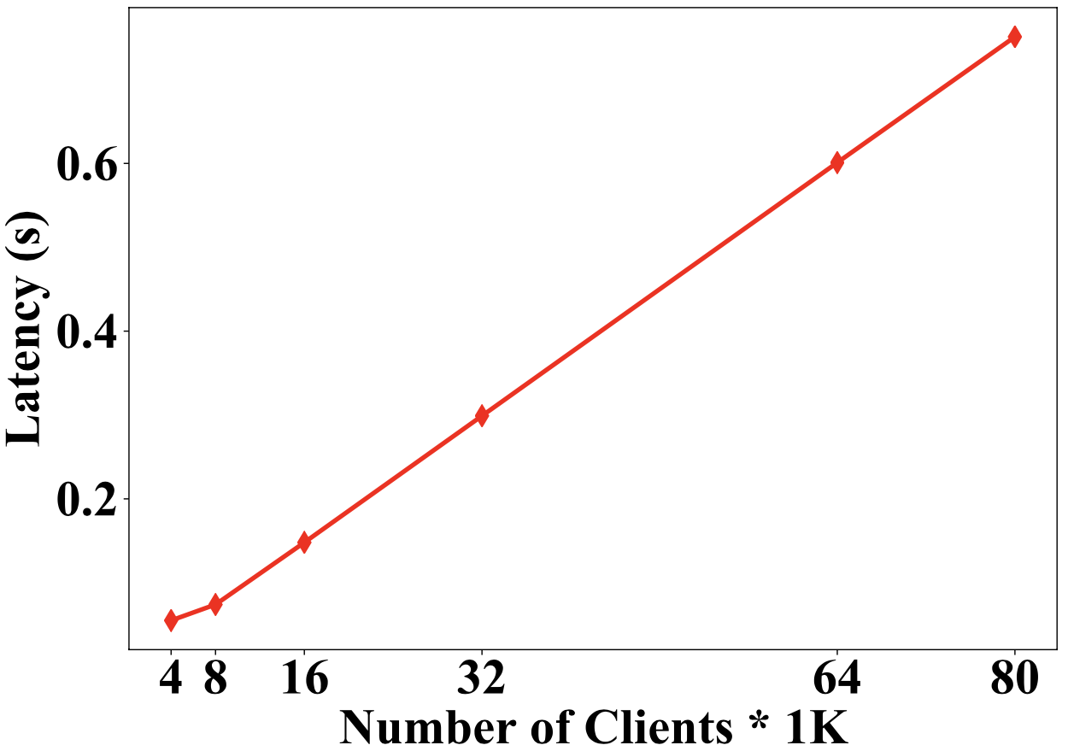
Insight 4: Number of Clients
Too many clients → increases average latency.

Slide 21
Conclusions and Final Remarks
There are several factors that affect throughput of a blockchain system.
Fast consensus does not always implies an efficient blockchain system.
We show that a well-crafted system-centric permissioned blockchain system can outperform a protocol-centric blockchain system.
System designers need to dissect their application to find performance bottlenecks.

Slide 22
Thank You

